Slide 1

Cyclistic Bike Share
Analysis to Identify customer demand at different station locations to increase Cyclistic’s Customer Base.
MaheshKarthika

Slide 2
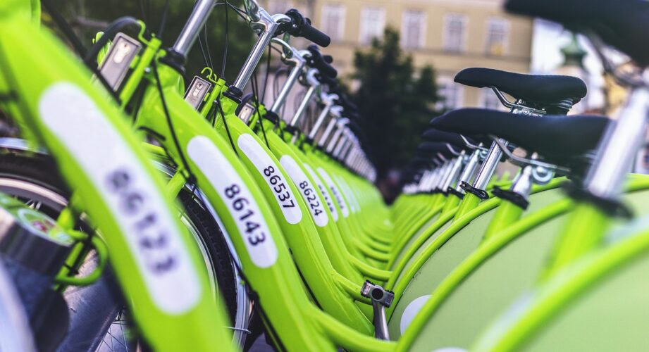
Business Problem
Background
In this fictitious workplace scenario, the imaginary company Cyclistic has partnered with the city of New York to provide shared bikes. Currently, there are bike stations located throughout Manhattan and neighboring boroughs. Customers are able to rent bikes for easy travel among stations at these locations.
Scenario
Detailed understanding of the bike trends will help to understand how customers are using their bikes and their demands at different station locations currently and how it can be improved in future.
Goal
Provide customers with better experience and grow the customer base.

Slide 3
Analyzing the data
Analyze the trends of bike trips in each of the New York boroughs during summer months.
Summer Trend
Seasonality
Identify the cyclistic trends throughout the year.
Visualize the total number of bike trips in 2019 and 2020 based on user type.
Top Trips

Slide 4
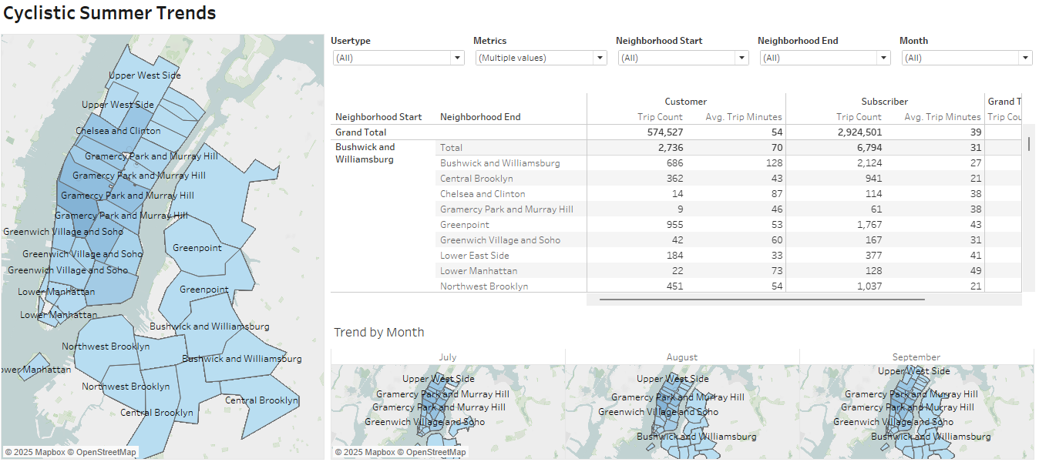
Cyclistic Summer Trends
The largest map shows trend from each of the boroughs.
The table compares the number of trips and average trip minutes for customers and subscribers in each neighborhood.
Three smaller maps focus on July, August, and September: the three months with the highest bike traffic.

Slide 5
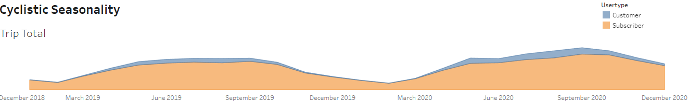
Cyclistic Seasonality – Trip Total
This chart shows that subscribers make up a significantly larger portion of Cyclistic’s users than regular customers.
It also shows that there are far more users in warmer months (May–October) than there are in colder months.

Slide 6
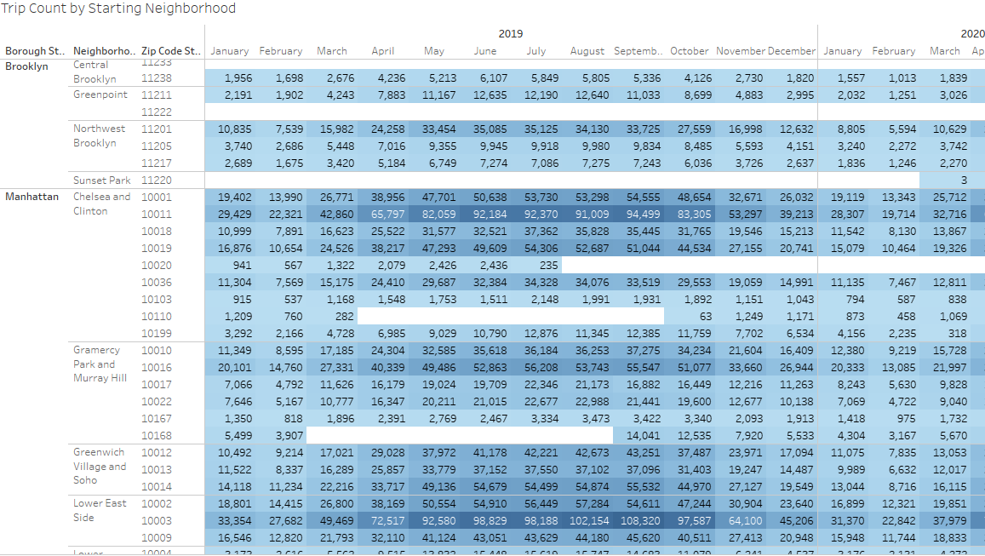
Cyclistic Seasonality - Trip Count by Starting Neighborhood
Starting location is more indicative of where users look for a bike, it is more important to emphasize starting location when determining where to advertise.
The most active stations are in the Lower East Side and the Chelsea and Clinton neighborhoods.
The most active months are from May to October.

Slide 7
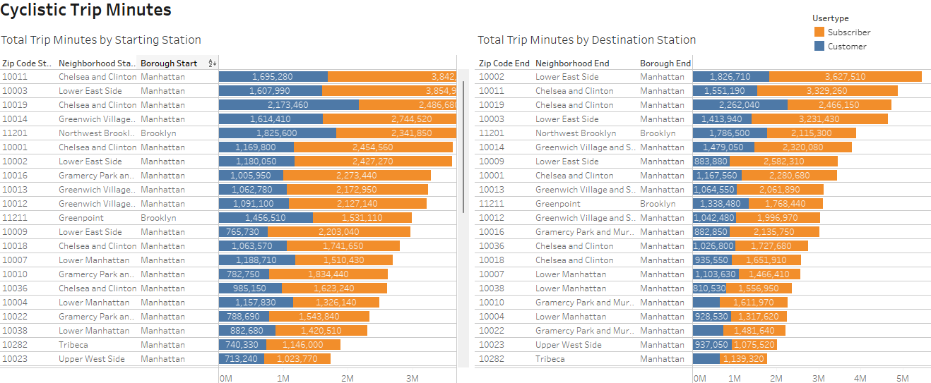
Cyclistic Top Trip
Compare the total number of trip minutes by starting neighborhood and ending neighborhood for both customers and subscribers.
Lower East Side and Chelsea and Clinton neighborhoods have the highest total trip minutes for both start and end stations.

Slide 8
Thank You

